Slide 2
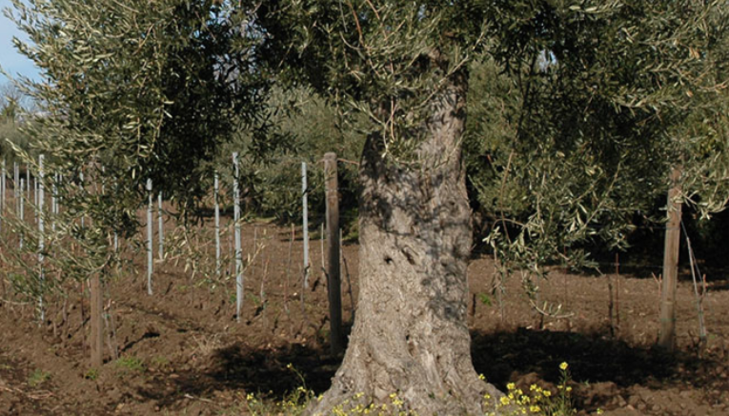
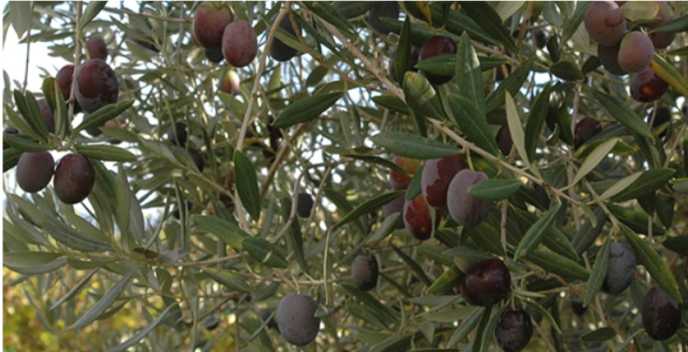
Tenuta delle Terre Nere owns roughly 1500 olive trees, which flourish on the charming terraces of all the properties on Northern slope of the Etna Volcano, within the Contradas of Castiglione di Sicilia and Randazzo, where they ardently cohabitate with the vines.
Many of them are centuries-old, expertly preserved and raised – and farmed organic.
Native varities are grown only: Nocellara Etnea and Brandofina, known here as «Randazzese».
Nocellara Etnea variety is uniquely and predominantly cultivated all around the feet of the Volcano, mainly thanks to it resilience, as it is able to grow in extreme climate and soil conditions.

Slide 3
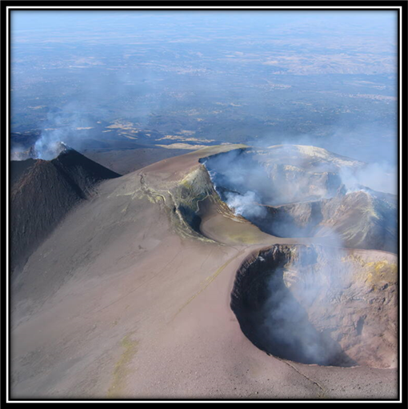
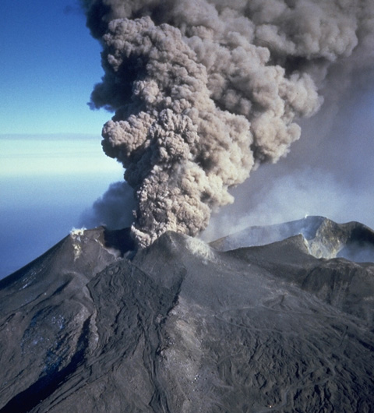
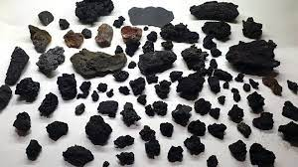
As for all the agricultural activities, our volcanic soil – in all its facets/in its diversity – has always been the best and most beneficial condition for the olive farming.
Indeed, the abundance of components gathered and eroded over the millennia - lava flows and other pyroclastic products from the eruptions (lapilli, ashes) - containing valuable minerals such as magnetite, olivine, pyroxene, hornblende, hematite and goethite, promotes and boosts the growth of olive trees, characterising our Extra-Virgin Olive oil with such uniquely intense, refined and complex bouquets .

Slide 4
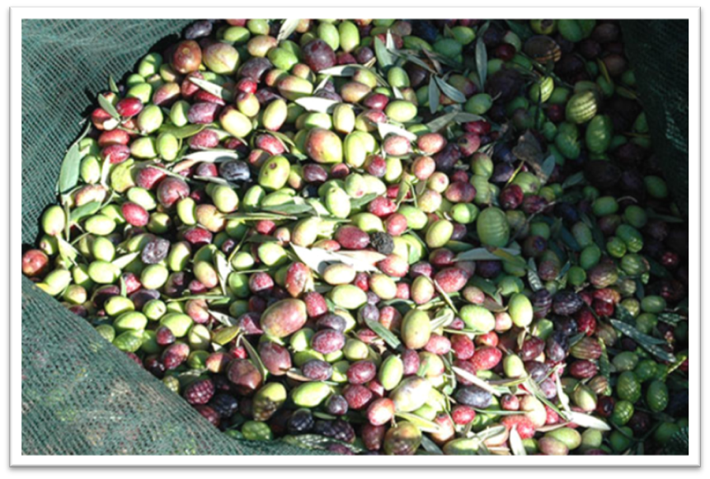
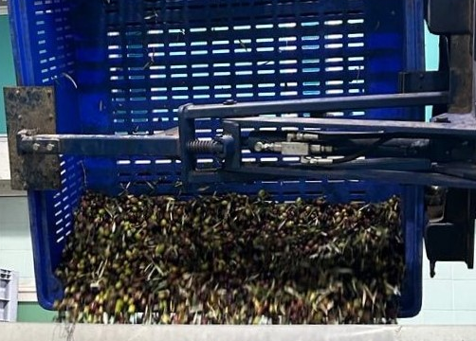
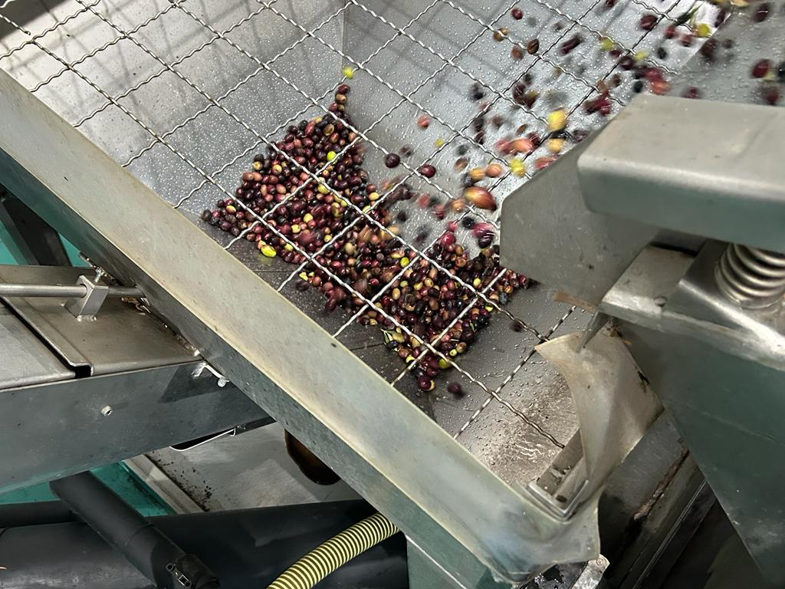
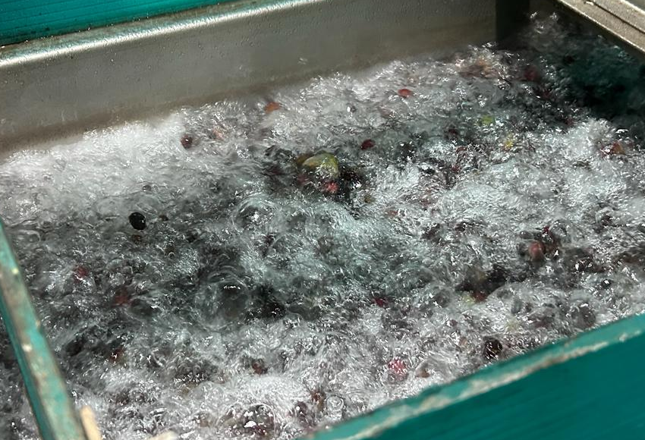
Usually, the harvest starts middle November, and it ends not before December.
Every day’s crop is always processed every evening, in order to preserve the finest quality of the fruits picked.
After the harvest, the olives are carried to the oil mill.
There, the first step is the cleaning process: initially, the olives get separated from any sort of contaminants (stones, leaves, dirt), and then they get de-leafed and generously washed in water (as shown in pictures below).

Slide 5
At this stage, the real oil extraction phase begins: the olives get mechanically pressed (grind), and the olive paste resulting is then subjected to the kneading process, consisting of a continuous mixing of the dough (as shown in the video, press play).
This is a crucial moment for the olive oil production, as through the kneading the olive paste becomes more consistent and homogenized, in order to maximise the oil extraction.
For the entire procedure, temperature must be kept below 26° Celsius (the so-called «cold extraction»).

Slide 6
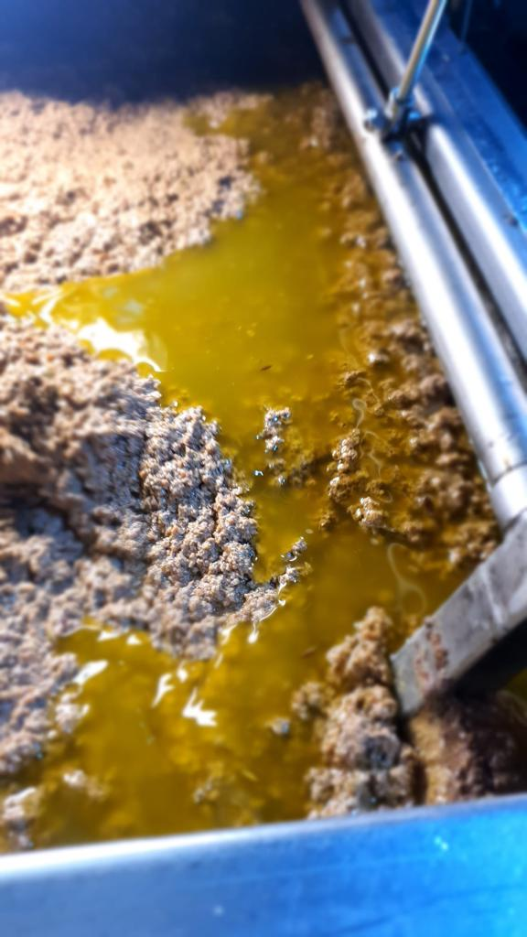
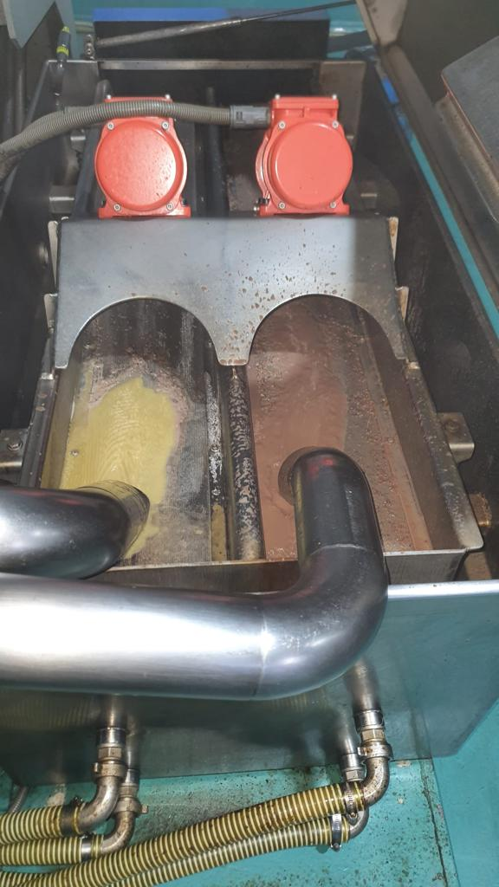
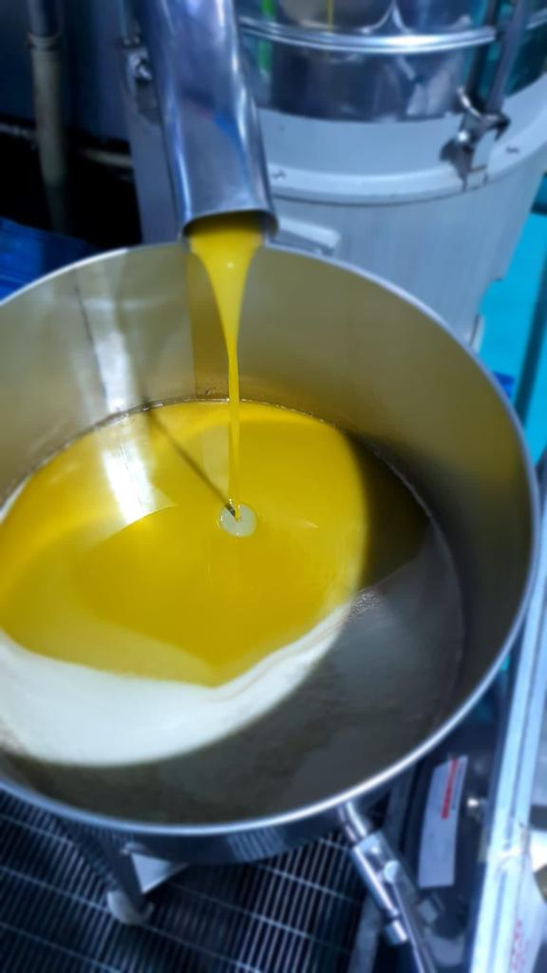
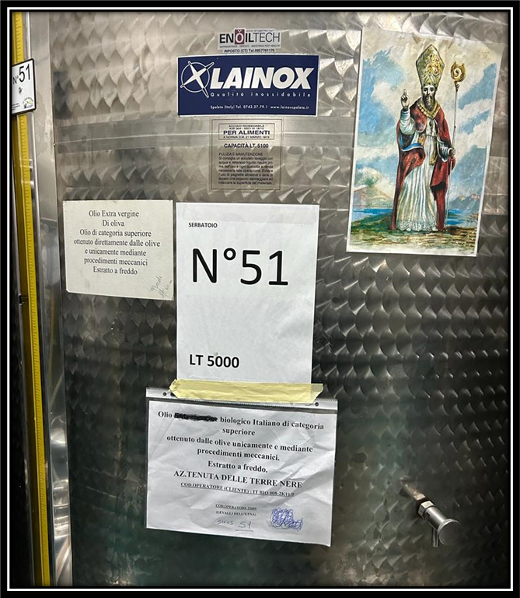
After, the paste goes inside a horizontal centrifugal decanter: here, through the rotation, the oil gets finally separated from all the solid components and water (pictures show: the paste before going into the decanter, the separation and the final olive oil extracted).
The olive oil is then stored in stainless steel tanks and left to naturally decant until February, when it gets bottled without filtering.
P.S. The Saint is a must in Sicily !!!

Slide 7
Production area: townships of Randazzo and Castiglione di Sicilia;
Exposure: Northern slope of Mount Etna, from 600 mt a.s.l. up to 900 mt a.s.l.;
Characteristics of the soil: volcanic soil
Olive varietals: Nocellara Etnea, Brandofina;
Average age of the trees: 100 up to 150 years old;
Harvest: manual, from half November until the first week of December;
Milling: cold-pressed; bottled unfiltered;
Colour: golden yellow with light green hues;
Nose: Fine aroma of tomato emphasized by fresh hints of green almond, aromatic herbs, mown grass, artichoke and chicory.
Flavour:Spicy in its youth, delicate and balanced after, it enriches every dish with gentle finesse, without intrusiveness

Slide 8
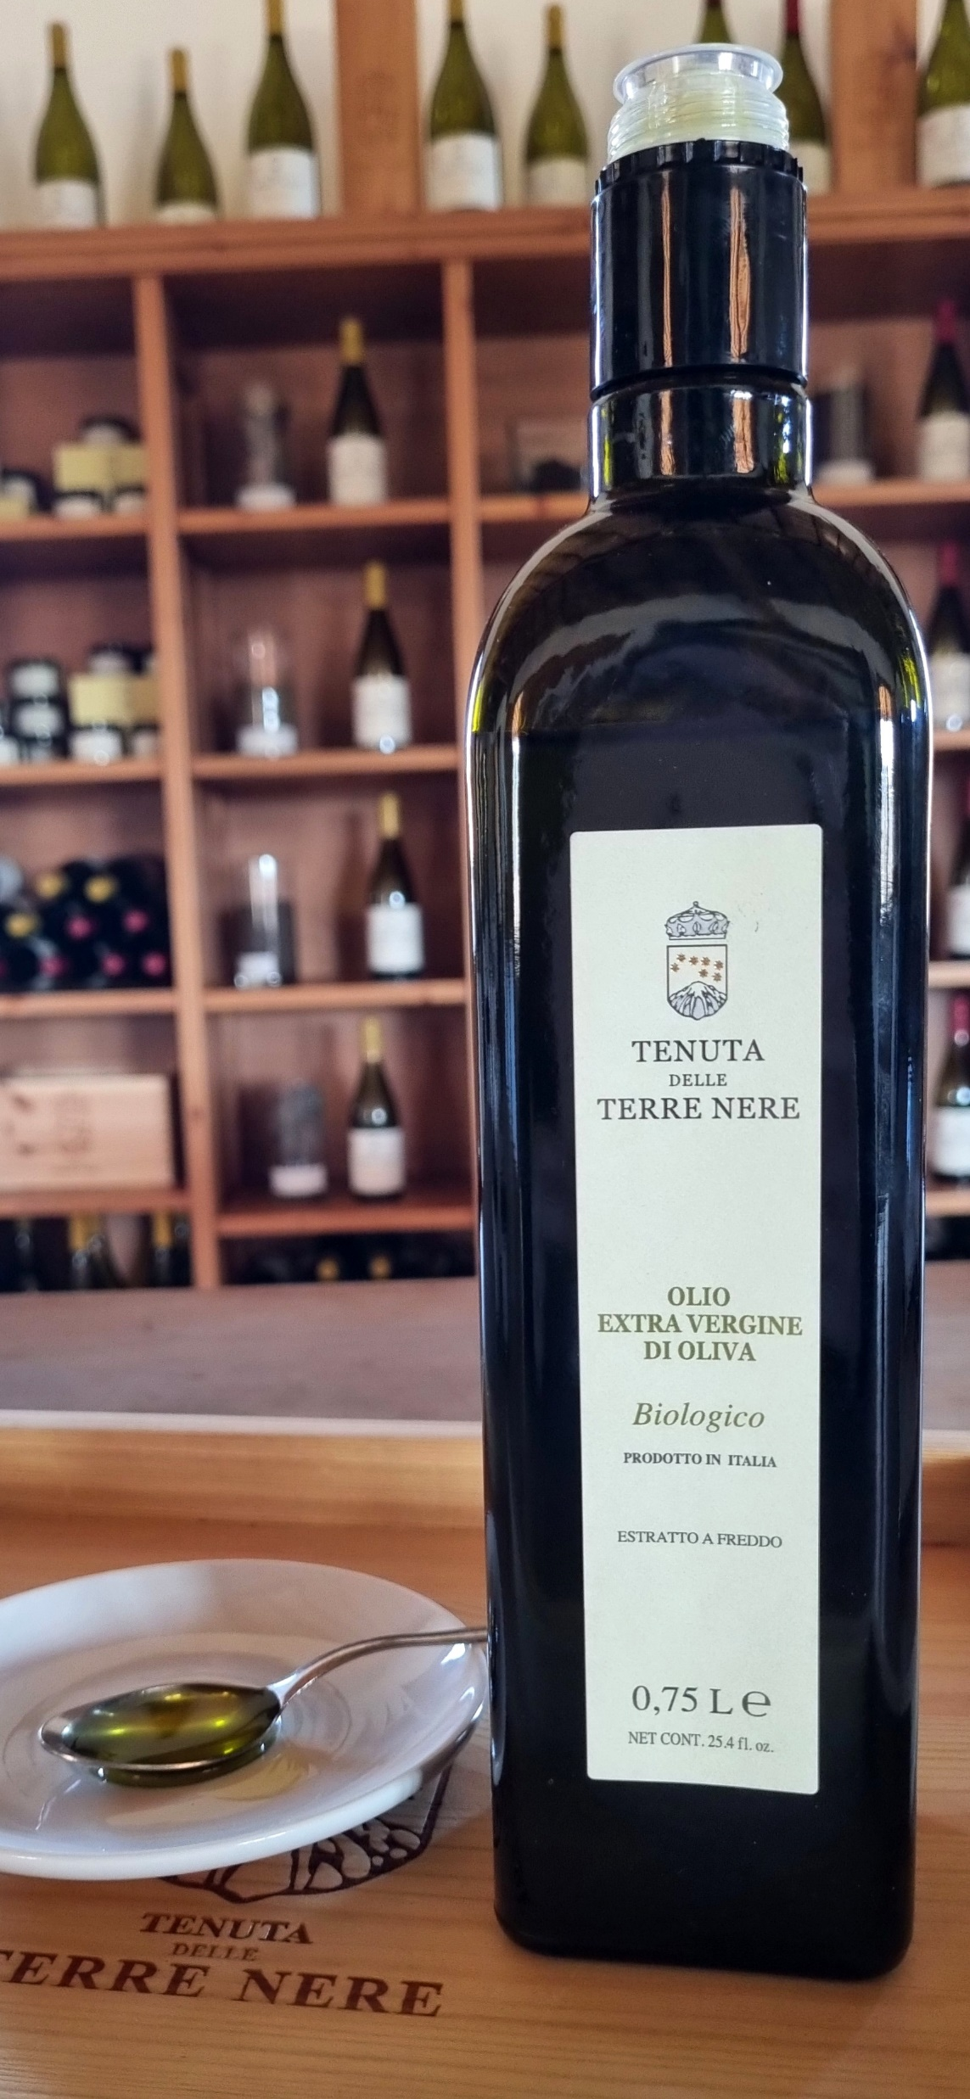
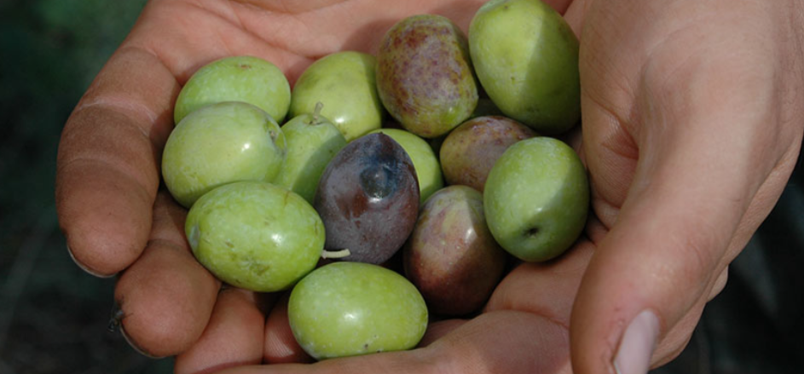
It is possible to visit our olive groves and taste our Extra Virgin Olive Oil at the Estate.
Discover our vision and commitment to Etna’s unique microcosm and superb nectars through a guided wine tasting experience with us.
Reserve your favourite: https://www.tenutaterrenere.com/en/book/

Slide 9
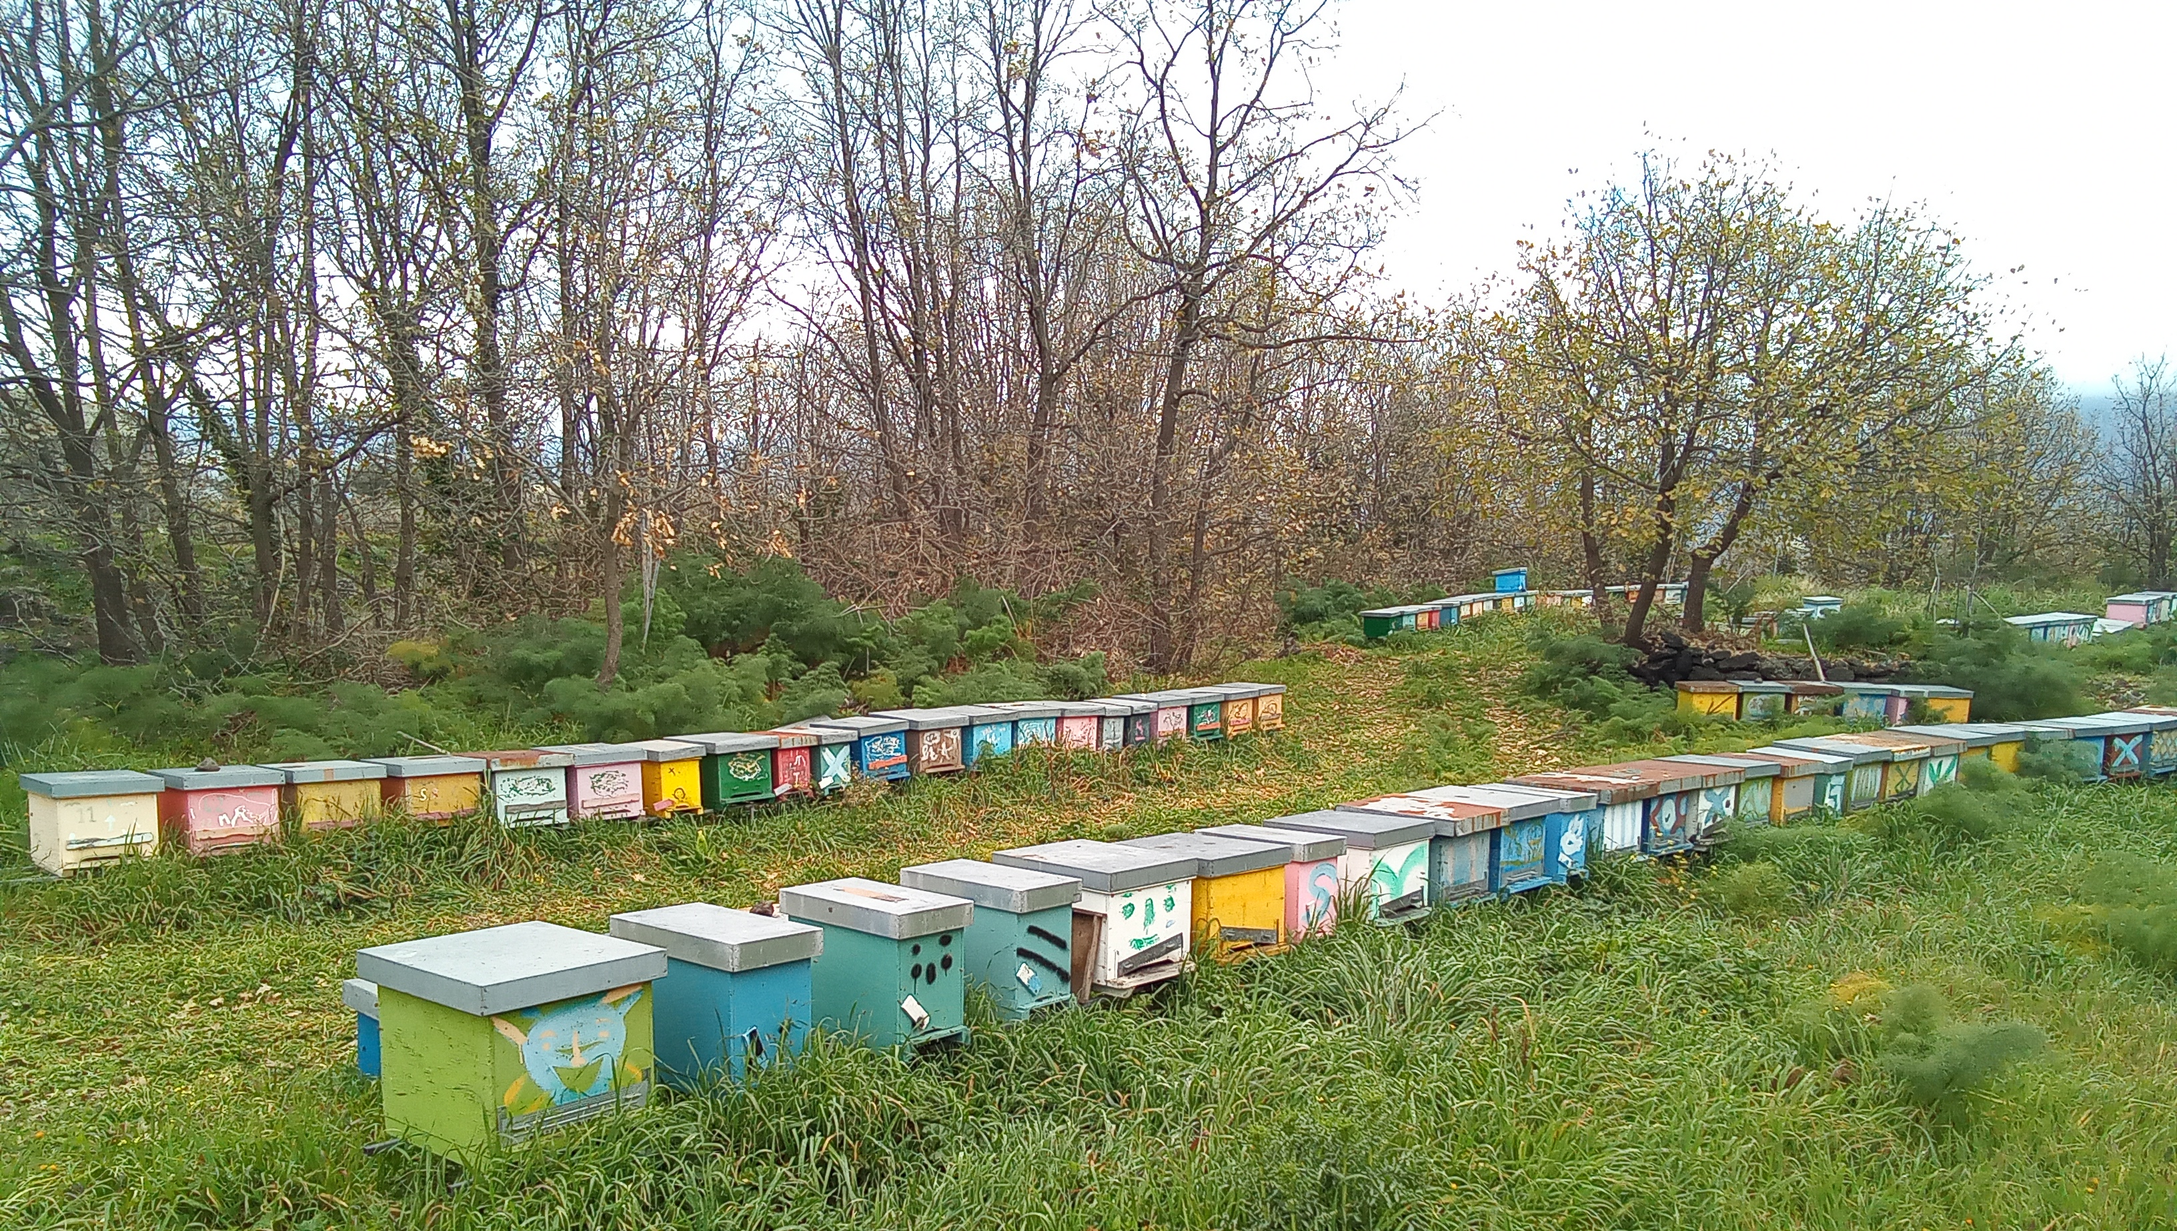
Tenuta delle Terre Nere’s devotion for Nature’s wonders goes even further: since the Estate’s establishment, back in 2002, we made and still consider sustainability as one of the first principles of our philosophy.
We are responsible for our planet’s well-being and we truly believe that what is taken from the environment should be subsequently returned.
Our honey project, which is completely non profit at all, is part and parcel of our environmentally-conscious vision: we are aware of the importance of bees for our planet’s health, and not only we want to support their work, but we want to spread the awareness.
(the picture shows our beehives, in Contrada Calderara).

Slide 10
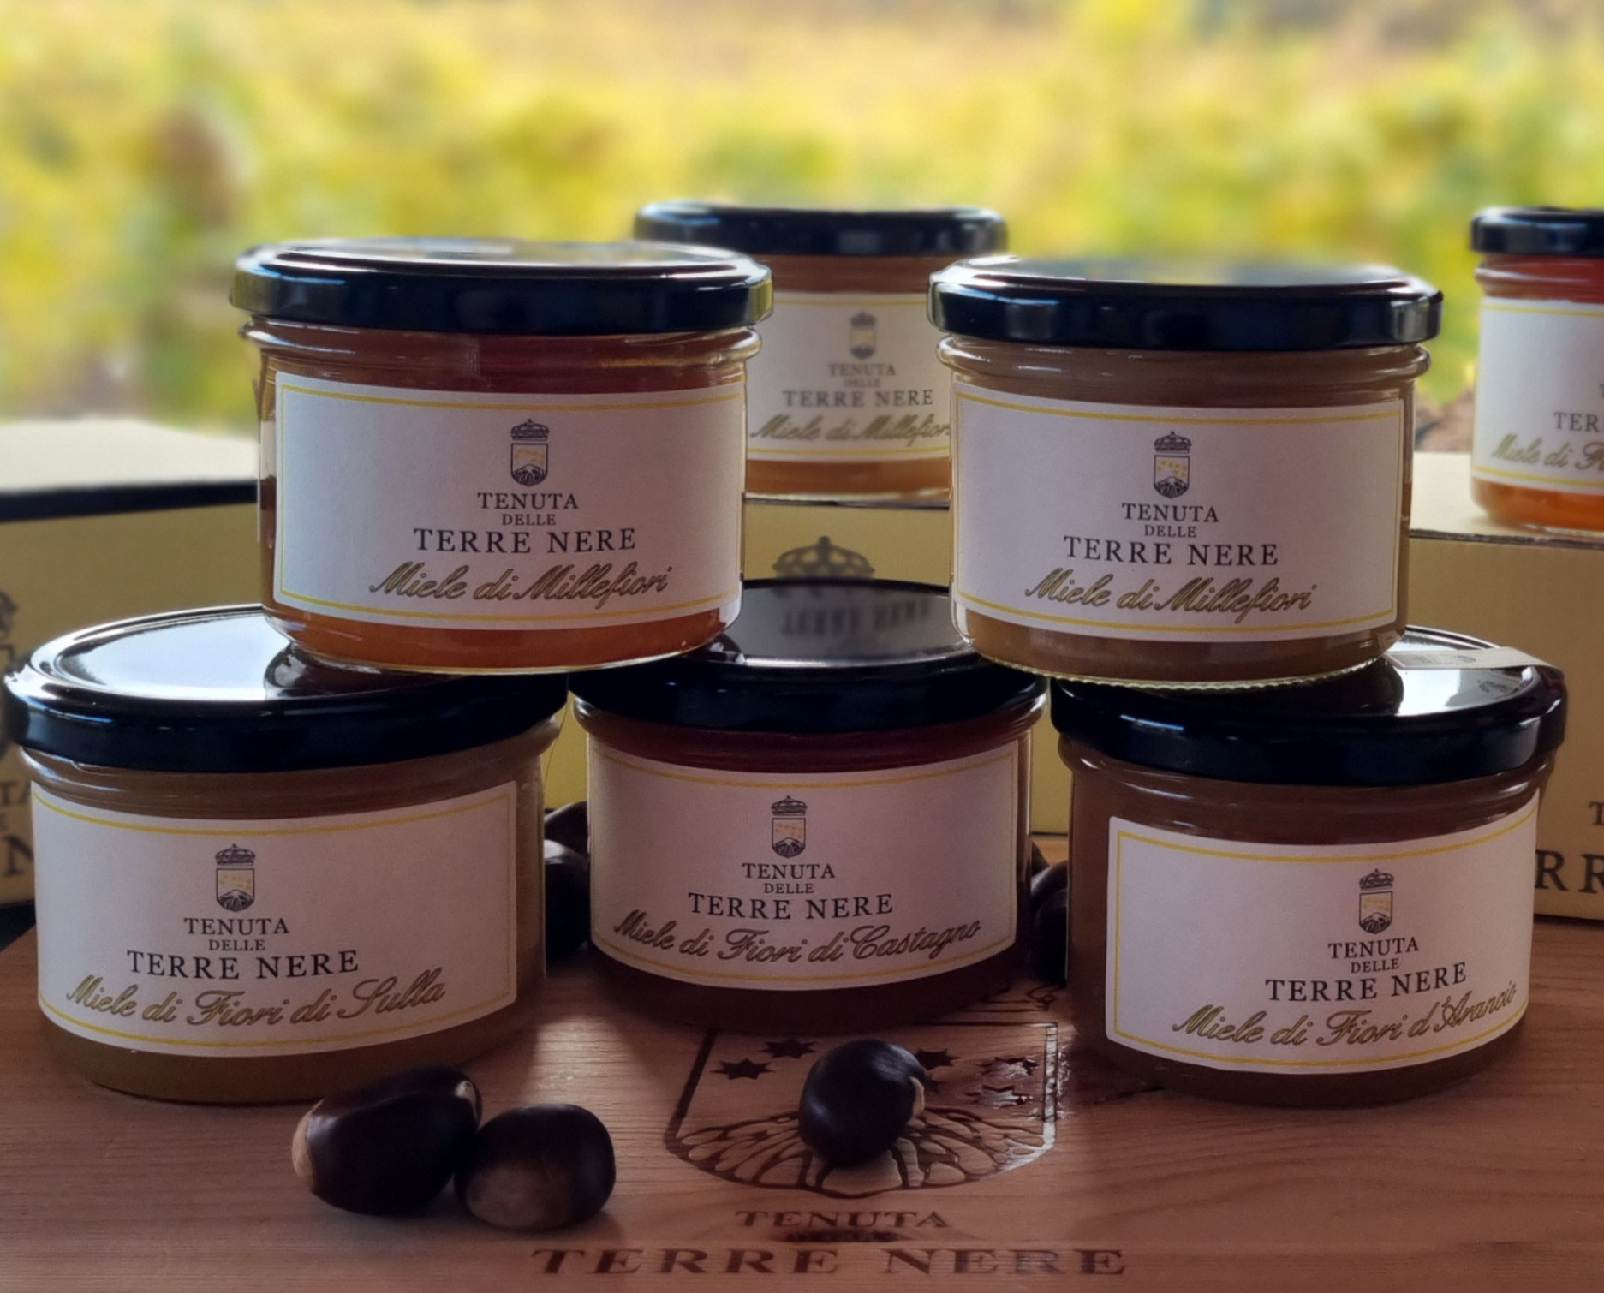
Honeys produced on the Etna are of a marvelous quality and exceptionally perfumed.
Ours, they come in different varietis, every single year: Wildflower, Wildflower and Eucaliptus, Orange blossom, Sicilian Sainfoin, Chestnut.
Delights for our palates and souls!
A nice tasting of these delicacies is always included in our wine tasting experiences at the Estate.
Reserve your favourite on our website : https://www.tenutaterrenere.com/en/book/
(Press play)

